Slide 1
ELECTRONICS VIRTUAL LAB USING PYTHON GUI Final year Project by
Akash Dutta
Debabrata Debnath
Goutam Sutradhar
Dibyendu Paul
Paramita Chandra
Department of ECE, JIS College of Engineering, Kalyani, Nadia
Guided by
Mr. Arindam Banerjee
Asst. Professor,

Slide 2
Members
Akash Dutta (123180702003)
Debabrata Debnath (123180702023)
Dibyendu Paul (123180702024)
Goutam Sutradhar (123180702026)
Paramita Chandra (123180702041)

Slide 3
Introduction
Modules Used
Pulse-Width Modulation
Application UI - PWM
Temperature Measurement using TMP36
Application UI - TMP3
BCD to 7-Segment Display
Application UI – BCD to 7 segment display
Conclusion
Future Implications
Reference
INDEX

Slide 4
Introduction
Due Covid-19 pandemic, it has been practically impossible for students and Teachers to attend educational institutes.Although, Classes are going on virtually but it is quite difficult to perform the laboratory experiments virtually
.
Therefore, we have tried to make a simulation using python UI for students who want to perform Pulse-Width Modulation,Temperature Sensor and Flame Sensior as experiment in lab.
It contains various customizations for more specific outputs and empowers with detailed information.
Its difference with other Virtual Labs is that it works in offline mode which means even without the internet connection the experiment can be performed.

Slide 5




Modules Used
The whole code has in Python programming Language.
Libraries that has been used are:-
Tkinter is used Python standard library which provides an Object Oriented interface onto Tk/TCL. This enables to build a cross platform GUI for Python applications
Numpy is a Python library that helps to create N-dimensional arrays and apply mathematical operations on those with fewer lines of code.
SciPy is a free and open-source Python library used for scientific computing and technical computing.
Matplotlib is a Python library used for plotting the beautiful and attractive Graphs.

Slide 6
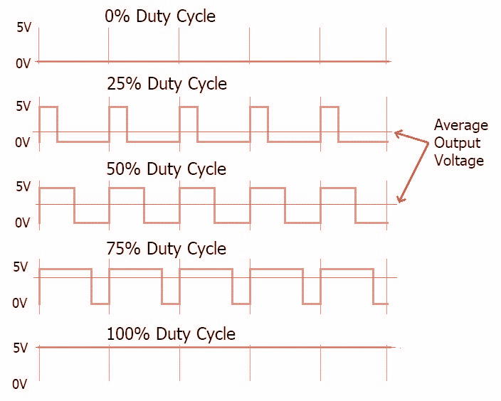
Pulse-Width Modulation
Pulse-Width Modulation also known as PWM is a type of signal which can be produced from a digital IC such as microcontroller or 555 timer.
It uses digital signals to control power applications, as well as being fairly easy to convert back to analog with a minimum of hardware.
The signal thus produced will have a train of pulses and these pulses will be in form of a square wave.
Duty cycle is the ratio of time a load or circuit is ON compared to the time the load or circuit is OFF. Duty cycle, sometimes called "duty factor," is expressed as a percentage of ON time.

Slide 7
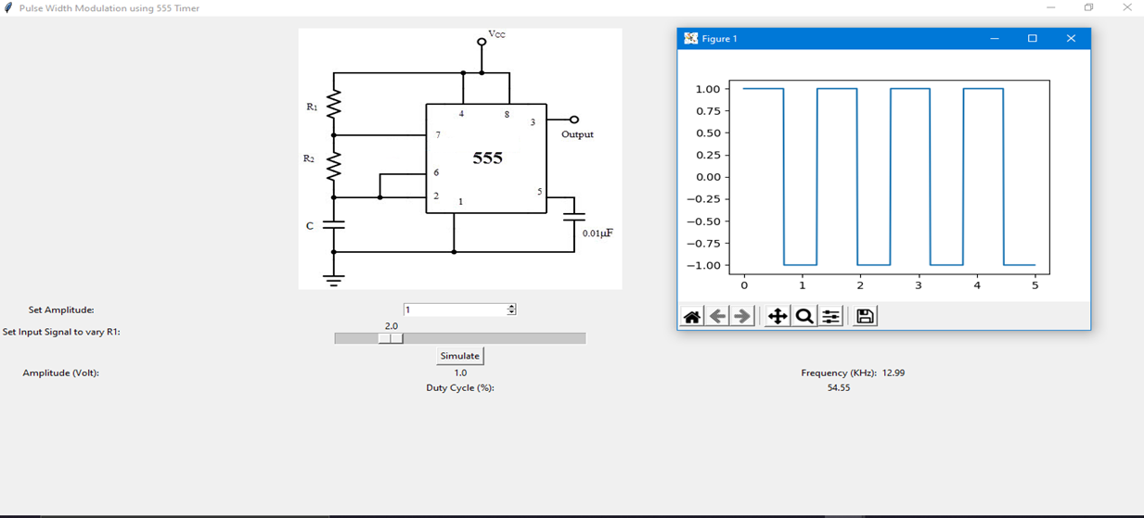
The Desktop Application for Pulse Width Modulation
Visual diagram of circuit for generating PWM with 555 Timer IC
Output Window showing the generated PWM signal (Graphical format)
Drop down menu to choose amplitude value
Output showing the frequency of the generated Pulse
Slider to change the value of the Resistor 1(R1)
Button to start the Simulation
Output showing the Duty Cycle of the Pulse

Slide 8
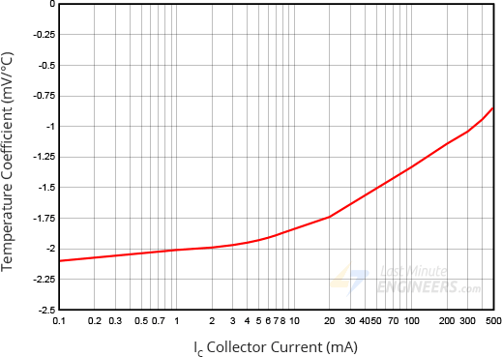
Temperature Measurement using TMP36
The TMP36 is a low voltage, precision centigrade temperature sensor. It is a chip that provides a voltage output that is linearly proportional to the temperature in °C and is, therefore, very easy to use with any microcontroller.
The voltage drop between the base and emitter (forward voltage – Vbe) of the Diode-connected transistor decreases at a known rate as the temperature increases(almost linearly).
This linear relationship between forward voltage and temperature is the reason why diode-connected transistors are used as temperature measurement devices.
The sensor can be powered from 3.3 or 5V output. The middle pin ‘Vout’ is the analog signal output from the sensor and connects to the A0 analog input of a microcontroller.

Slide 9
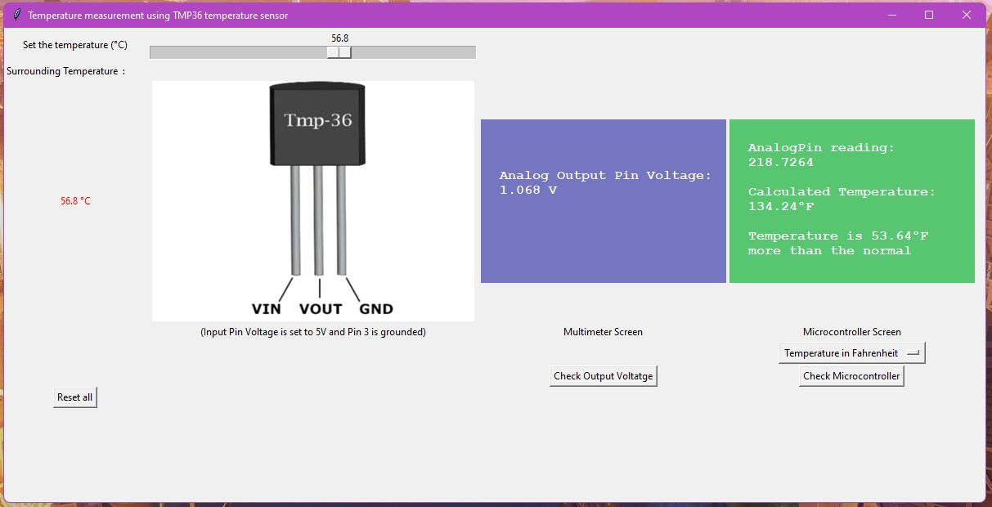
The Desktop Application for Temperature Sensing Simulation
Bar to control the temperature
Multimeter Screen measuring the Pin voltages of the Ic
Microcontroller Screen for results after calculations
Set Temperature in celsius
Section to choose temperature unit
TMP36 IC
Reset Button to reset all values
Button to check voltage in multimeter
Button to check various results in microcontroller

Slide 10
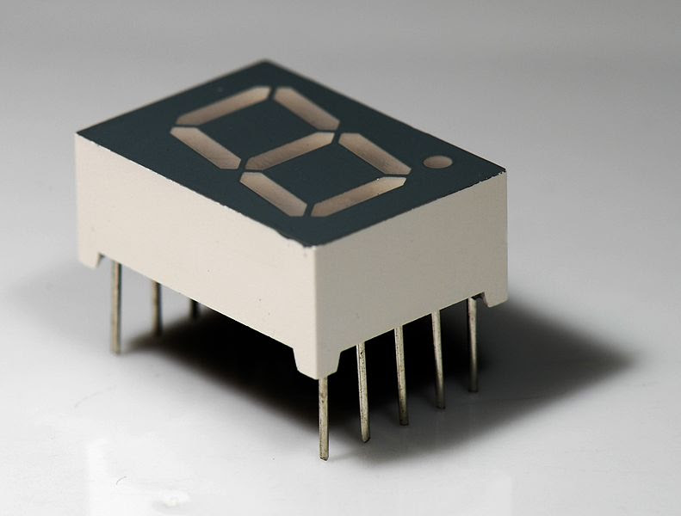
BCD to 7-Segment Display
7447 decodes BCD into 7 Segments. It accepts a binary coded decimal or BCD Values as input and decoded into a pattern that drives a 7-segment for displaying digits 0 to 9. Its input is 4 lines of BCD data and generates complements as output.
A seven-segment LED is a digital display module specialized to display numerical information.
The Display LED is segmented into 9 LEDs namely a , b, c, d, e, f and g which are connected to the output pins of the IC.
According to the combinations of outputs of the IC, the different LEDs of the Display turned On, making a numeric symbol on the display.

Slide 11
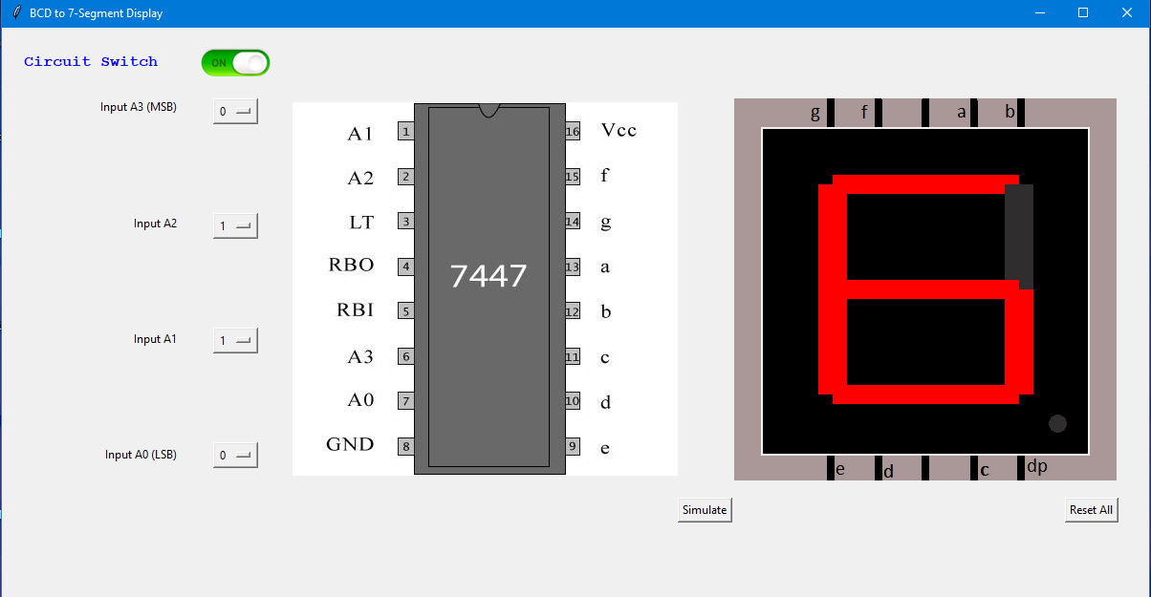
BCD to 7-Segment Display
Display LED
Button to switch on the Circuit
Button for Inputs of the IC
Button to start the Simulation
Reset Button to reset all values

Slide 12
Others Experiments that are included in the application :-
Realization of Basic Gates
Infrared Sensor Experiment
Soil Moisture sensor Experiment
Binary to Gray
Gray to Binary
Decoder
Encoder
Comparator
Multiplexer
Demultiplexer
Adders (Half and Full))
Subtractors (Half and Full)
Parity Generators ( Even and Odd)
Flipflops (JK, SR, T, D)

Slide 13
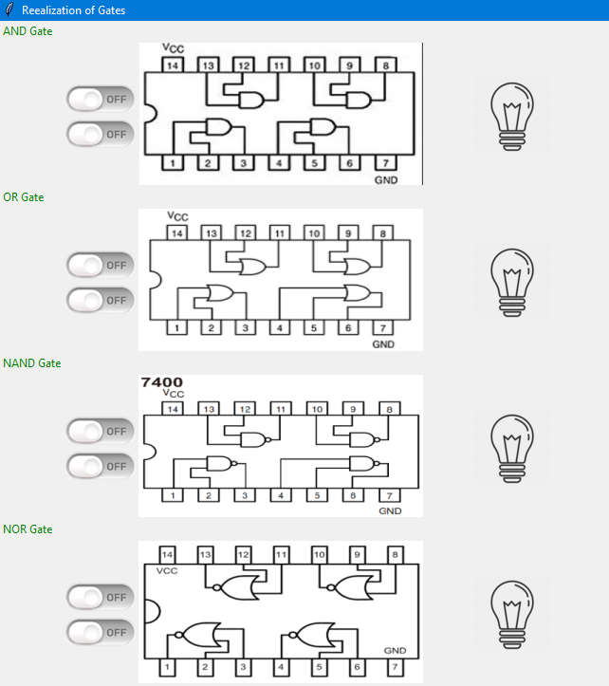
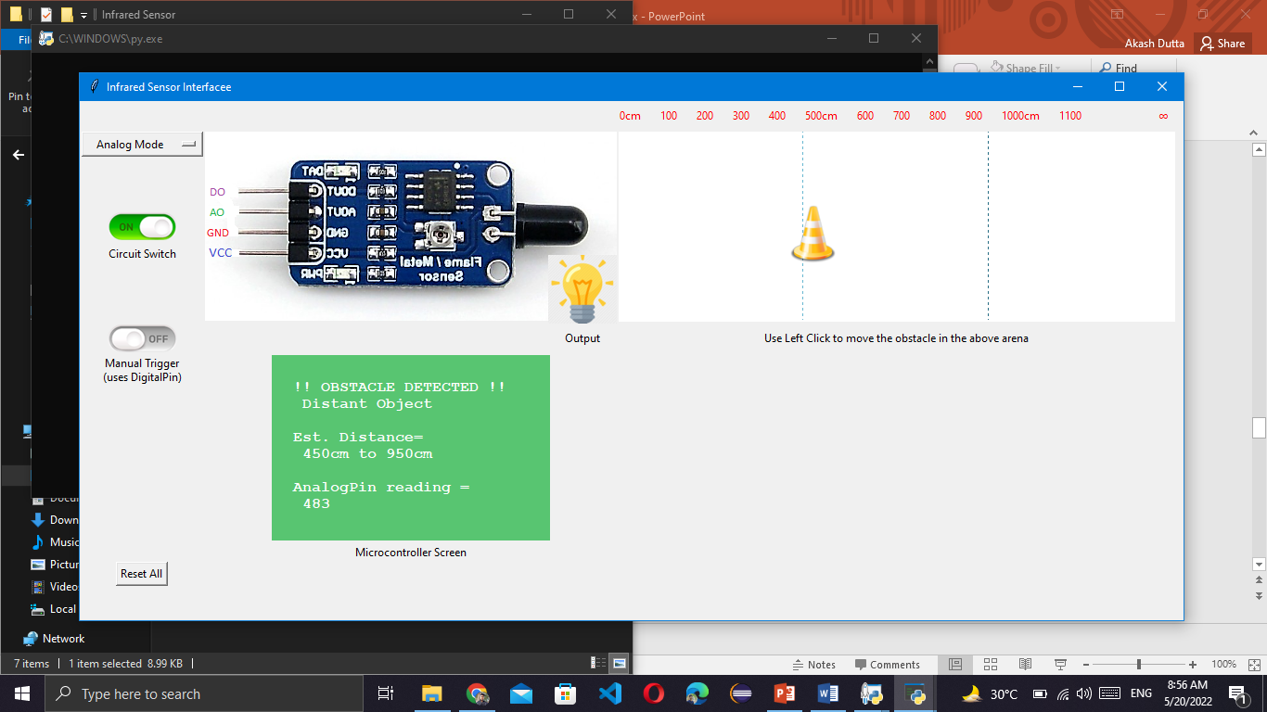
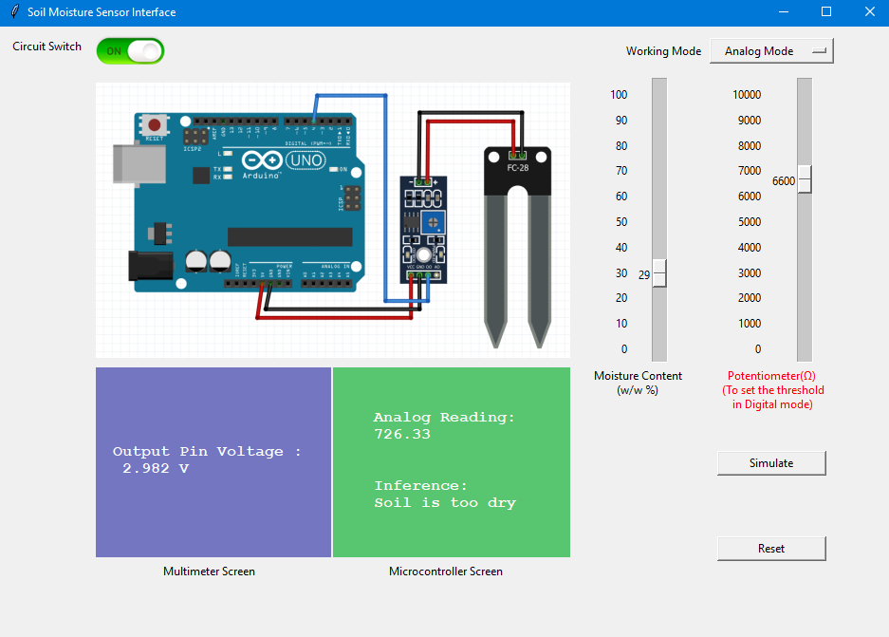
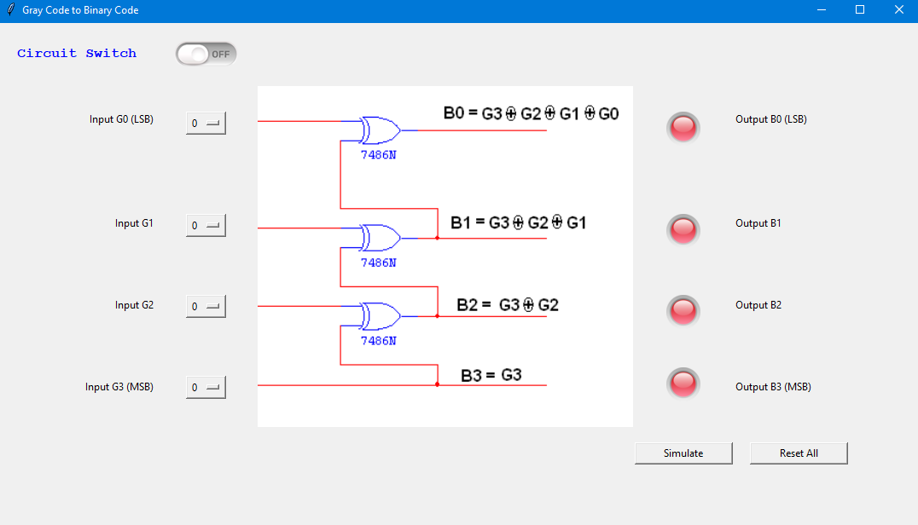
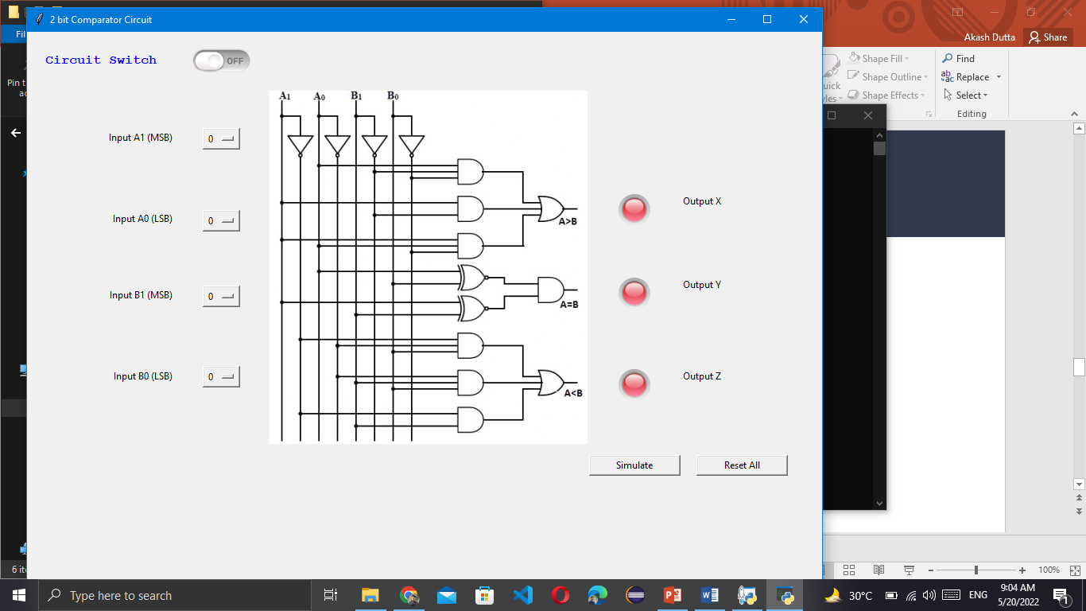
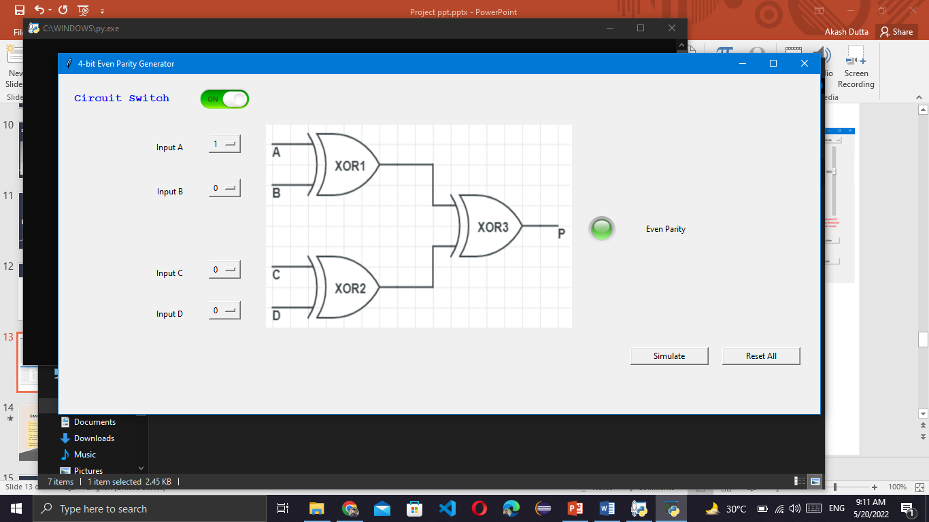
Basic Gates
Infrared Sensor
Soil Moisture sensor
Gray to Binary
Comparator
Even Parity Generator

Slide 14
Conclusion
The project has been developed keeping in mind the necessities of a student who were otherwise barred from the conventional Lab curriculums
Moreover the reading of the experimental data was compared with the real life output values of the sensors, which came out similar to that of the simulated.
The application was developed fully in the python programming language, and tkinter and other modules were used to build the interface. That means this application is platform independent and can be used by student in any system after certain installments.
Although utmost care has been taken to replicate the original experiments and results there may be some small discrepancies in results due to undesired errors.

Slide 15
Future Implications
The project has been developed keeping in mind the necessities of a student who were otherwise barred from the conventional Lab curriculums. Along with this, the platform can also be used by teachers for presentation and explanation purposes. This can benefit a broad spectrum of students and teachers to make them more familiar with the virtual world.
It is a small-sized offline simulation-based application for performing regular College level Electronics experiments. But if needed this can also be integrated to any site as an online based service (server based) .
With further developments, the application can be easily modified for experiments of other domains and subjects.
The application can also be integrated with hardware like arduino or raspberry pi so that they can act as dedicated experiments kits for the users.

Slide 16
References
[1] IIT Kharagpur, "Virtual Lab,"
[Online]:-Available:https://www.vlab.co.in/participating-institute-iit-kharagpur.
[2] IIT Guwahati, "Virtual Lab,"
[Online]:-Available:https://www.vlab.co.in/participating-institute-iit-guwahati.
[3] IIT Bombay, "Virtual Lab,"
[Online]. Available: http://vlabs.iitb.ac.in/vlab/.

